Slide 1
Module 1

Slide 2
6. LIFE PROCESSES

Slide 3

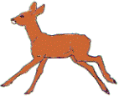

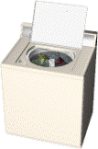
The world is made up of living and non-living things
living
non-living
On the basis of certain characteristics
Let us see what are these characteristics
Living
Non-living
How can you differentiate between living and non-living ?

Slide 4
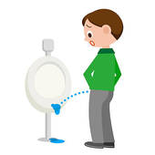
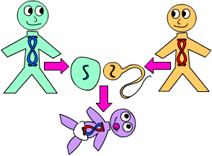
Characteristics of living things
Let us see what are these processes known as
Ability To Move
Ability To Move
Produce Offsprings
Turn Food Into Energy
Take Food To Stay Alive
Give birth to new individuals
Respond to external change
Get Rid Of Waste Matter
Respond And React

Slide 5

Processes like :
Help
Sustain
Nutrition
Are known as
Life processes
Respiration
Maintain life
Excretion
Transportation
Reproduction
Sensitivity
Growth
So we will learn about these processes in detail in this chapter called

Slide 6
6. LIFE PROCESSES

Slide 7
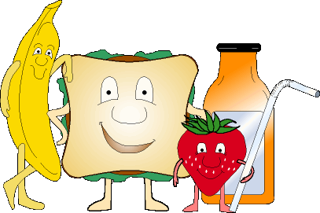
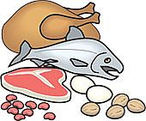
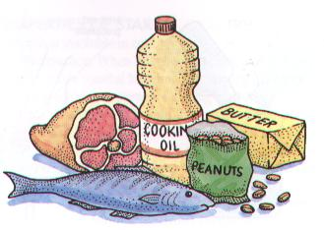
Nutrition :
need
Energy for growth and maintenance
obtained
contains
Living organisms
Food
Nutrients
Nutrients :
Substances which an organism obtains from its surroundings
and uses as a source of energy
Eg. : Carbohydrates, proteins, fats.

Slide 8
The process of intake of nutrients
and its utilization
by an organism
Use for various functions
is called as
Provides
Raw material to sustain life
Nutrition
WAYS OF OBTAINING FOOD
is known as
MODES OF NUTRITION
(Two types)
AUTOTROPHIC
HETEROTROPHIC

Slide 9
Thank You

